Slide 1
Website Presentation Johansone.github.io
Sintija Johansone
Boston, MA
2017

Slide 2
Having a Website
Andrea Lauer is a professional pastry chef from Latvia. She doesn't have a website yet, but she would like to create one, in order to increase the number of orders and to expand her small business.
A website is a good way to collect pictures of her work and to show them to clients. It also adds an opportunity for clients to order her cakes online.

Slide 3
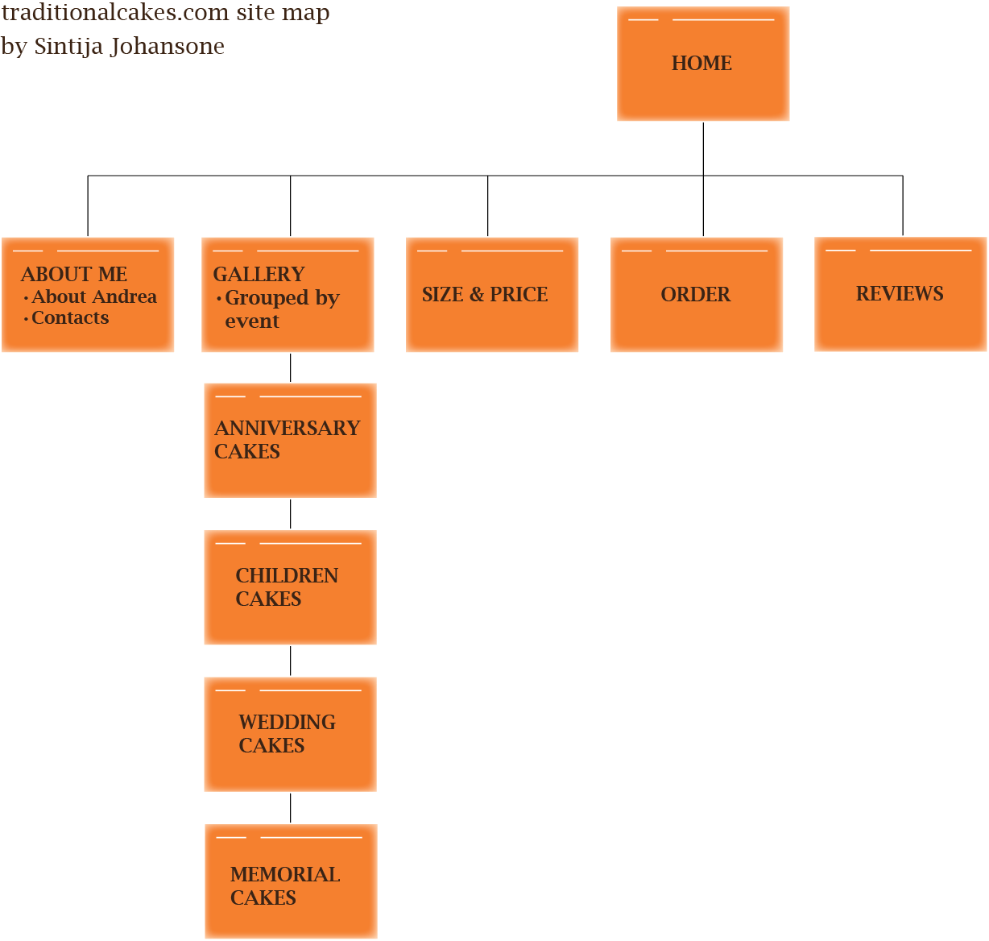
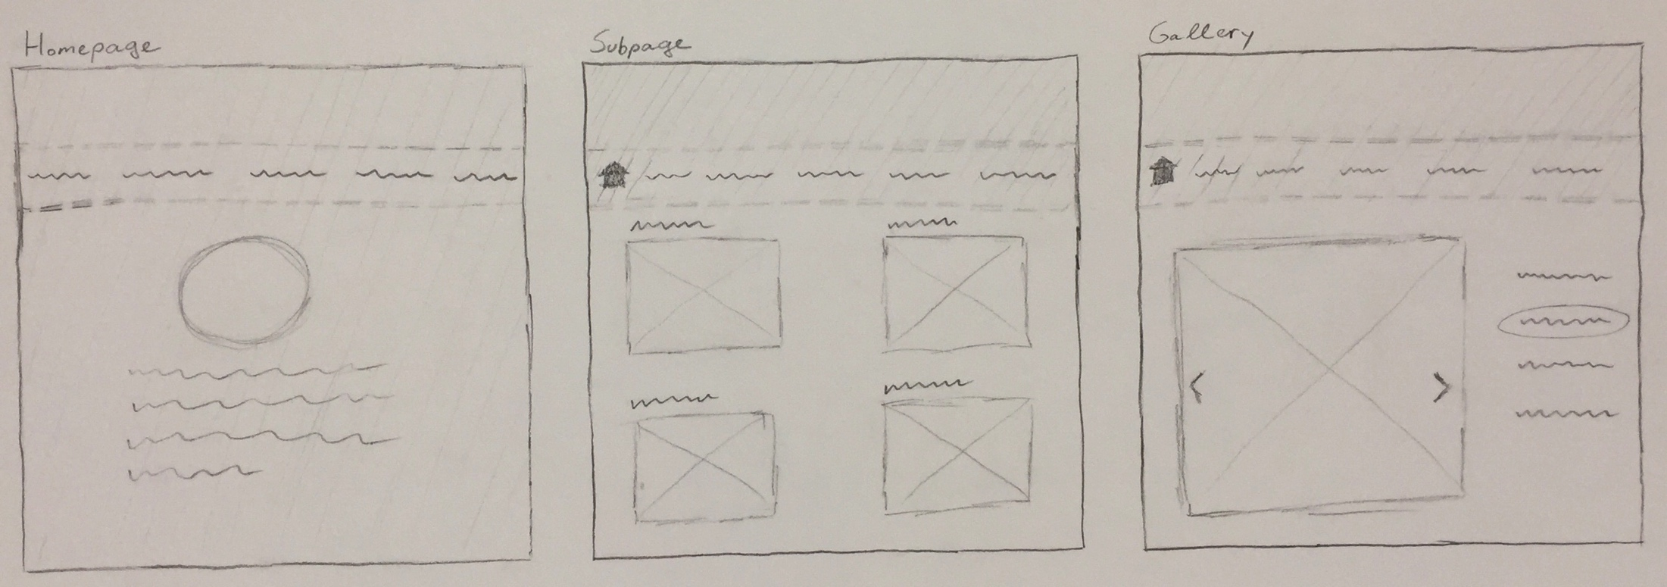
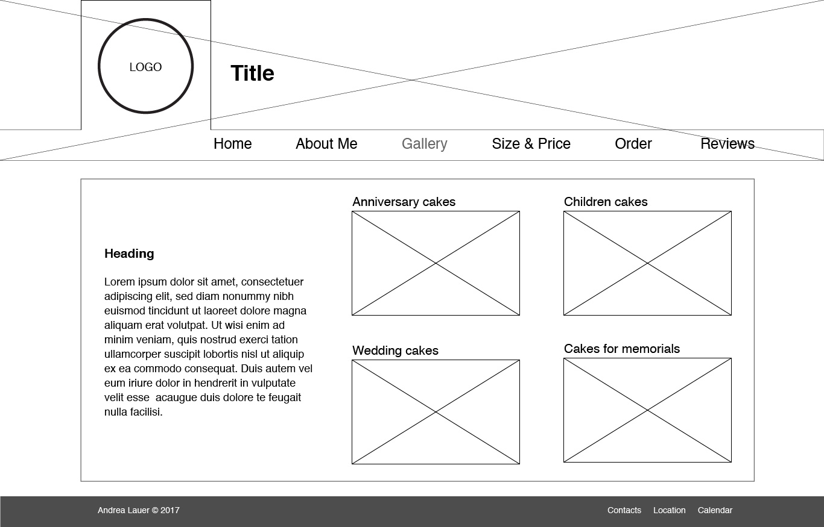
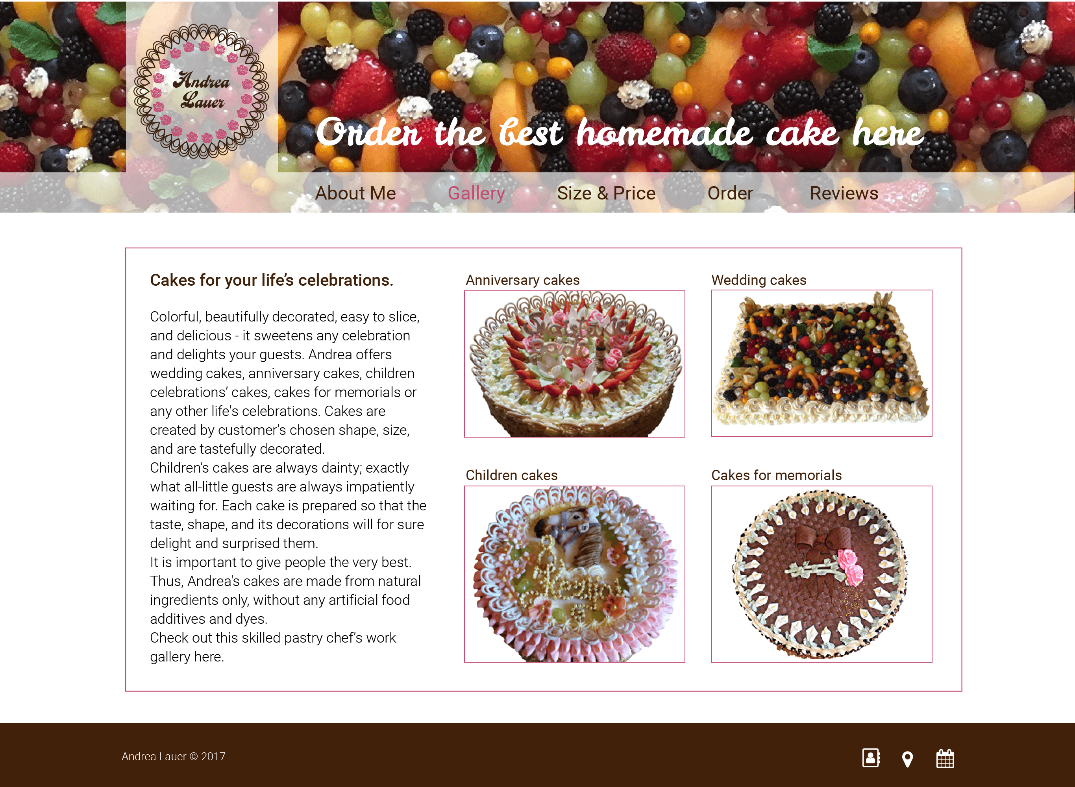
The Process of Work
Needs assessment
Architecture diagram
Sketches
Wireframes
Prototype
Code-based Website

Slide 4
The Process of Work
Collected all assets which might be useful
Sorted pictures in folders by their purpose and location on the website
Checked and corrected the pictures for using in the website
Made sure files have specific file names
Made and saved all the webpages and CSS style sheet
Started coding

Slide 5
The Process of Work
Coding
Began with two different templates and the style sheet
Based the remaining pages on the first two because some information overlapped
Determined what goes to the external style sheet and which parts are individual for each page

Slide 6
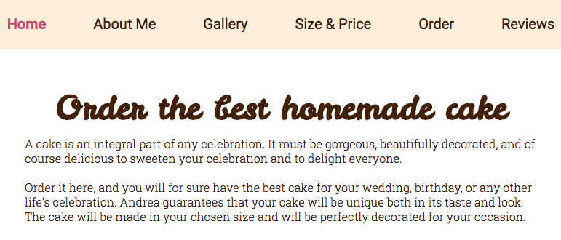
About the Website
The website’s typefaces are from “Google Fonts.” For subtitles and other captions “Roboto” type has been used because of geometric shapes and open curves. For easier to read larger paragraphs “Roboto Slab” has been used. The website’s title is in “Leckerli One.” Its irregular brush shapes remind of ornament shapes on Andrea's cakes.
Roboto - light, regular, bold
Roboto Slab - light, regular
Leckerli One - regular

Slide 7
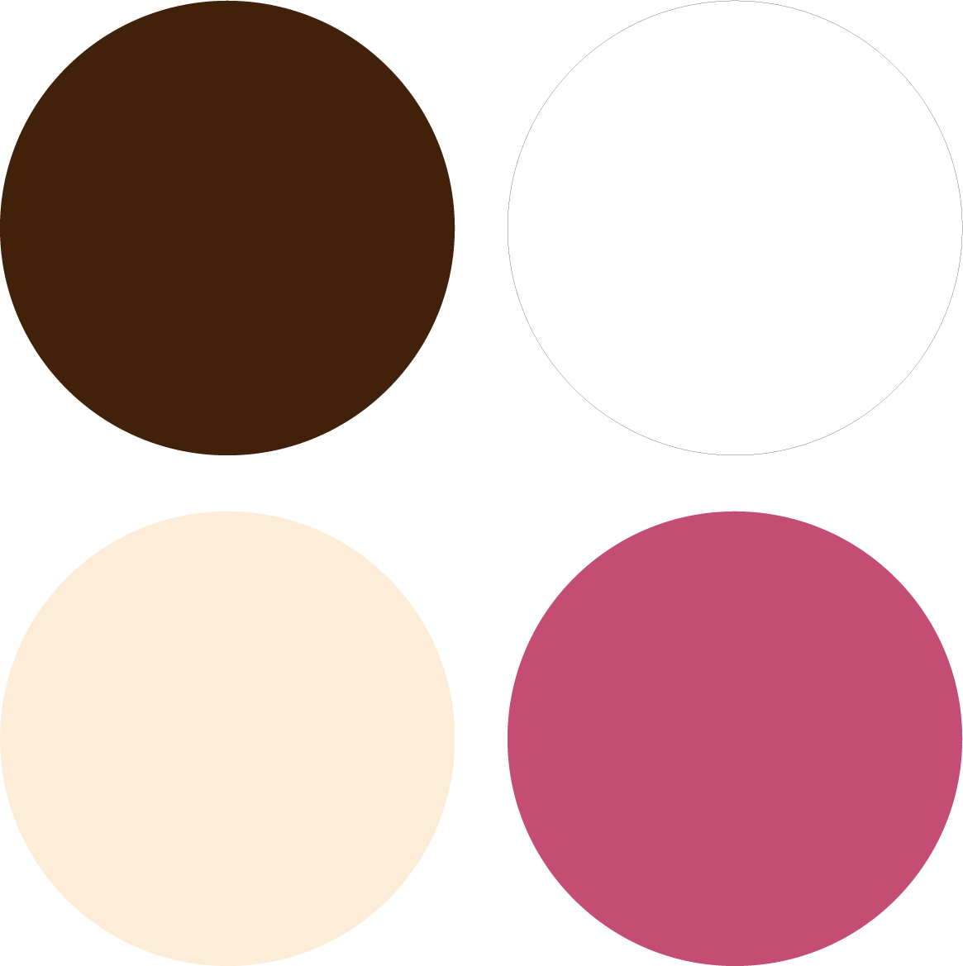
Used Colors
#42210b
#ffffff
rgba(243, 164, 64, 0.2)
#c44d74

Slide 8
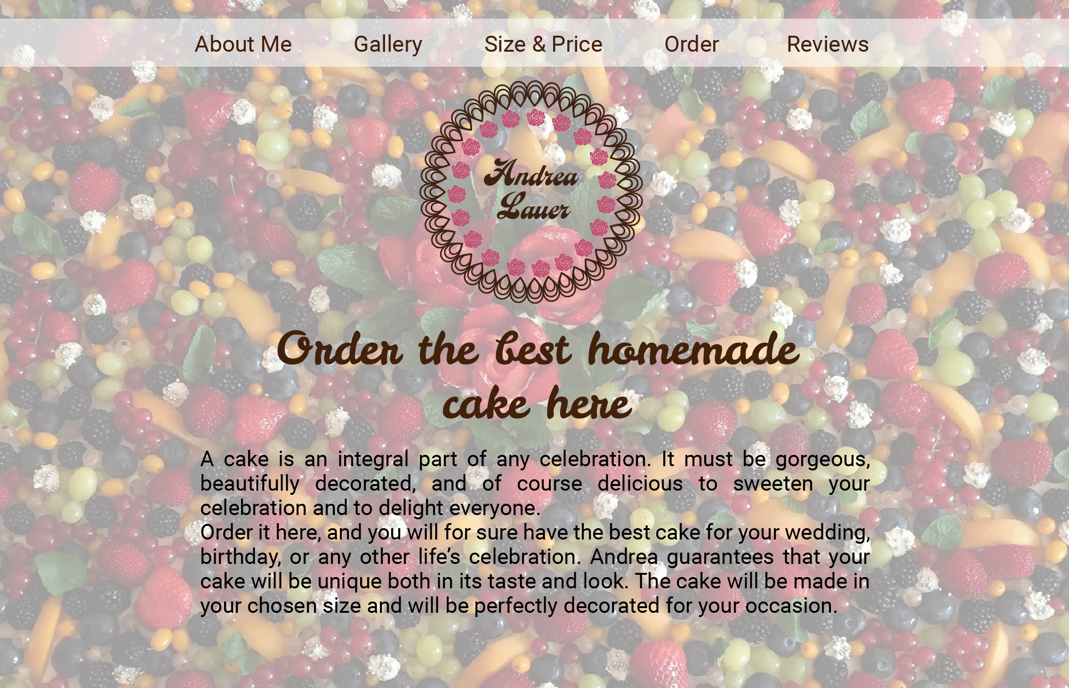
The Refinements Along the Way The first digital mockup of website’s Home page

Slide 9
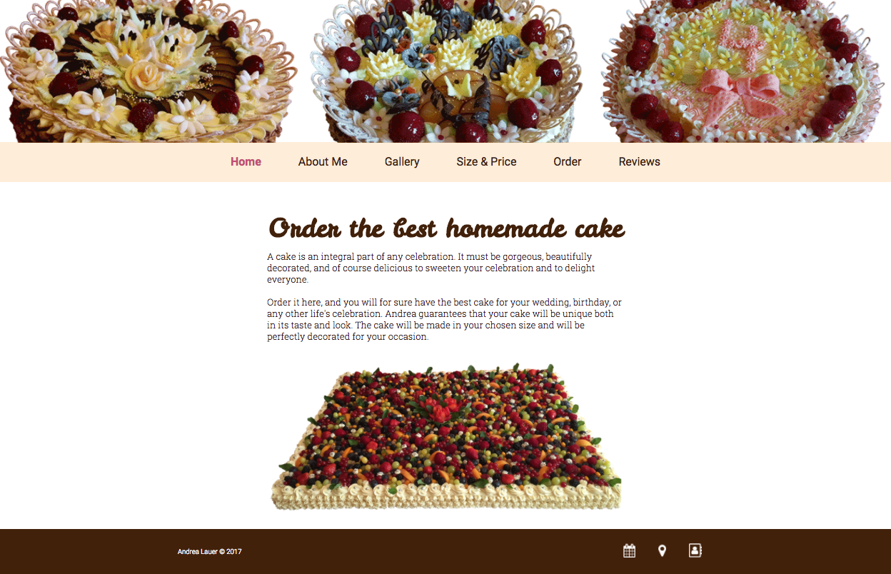
The website’s final Home page

Slide 10
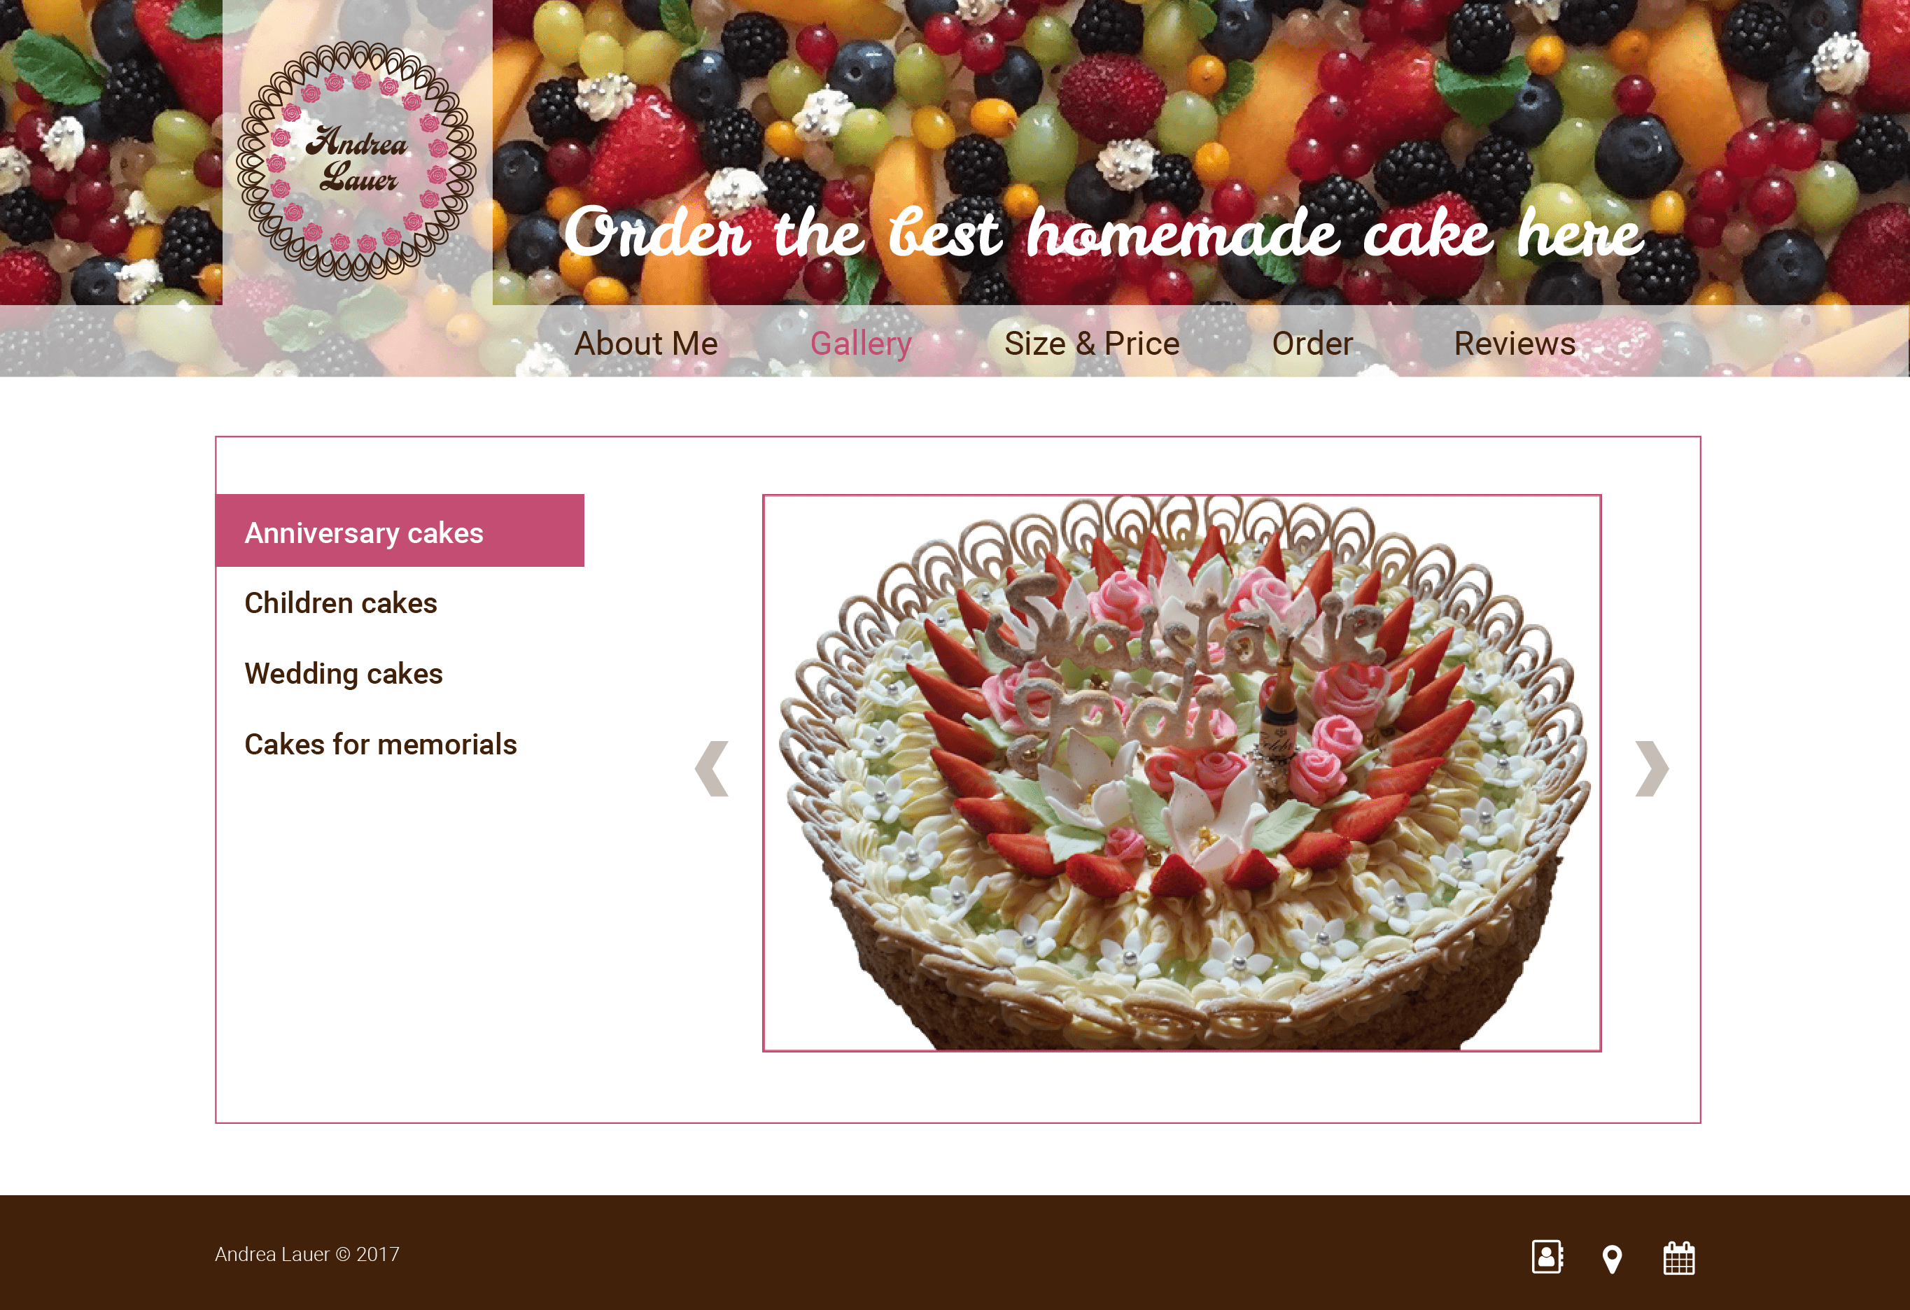
The first digital mockup for website’s Gallery page

Slide 11
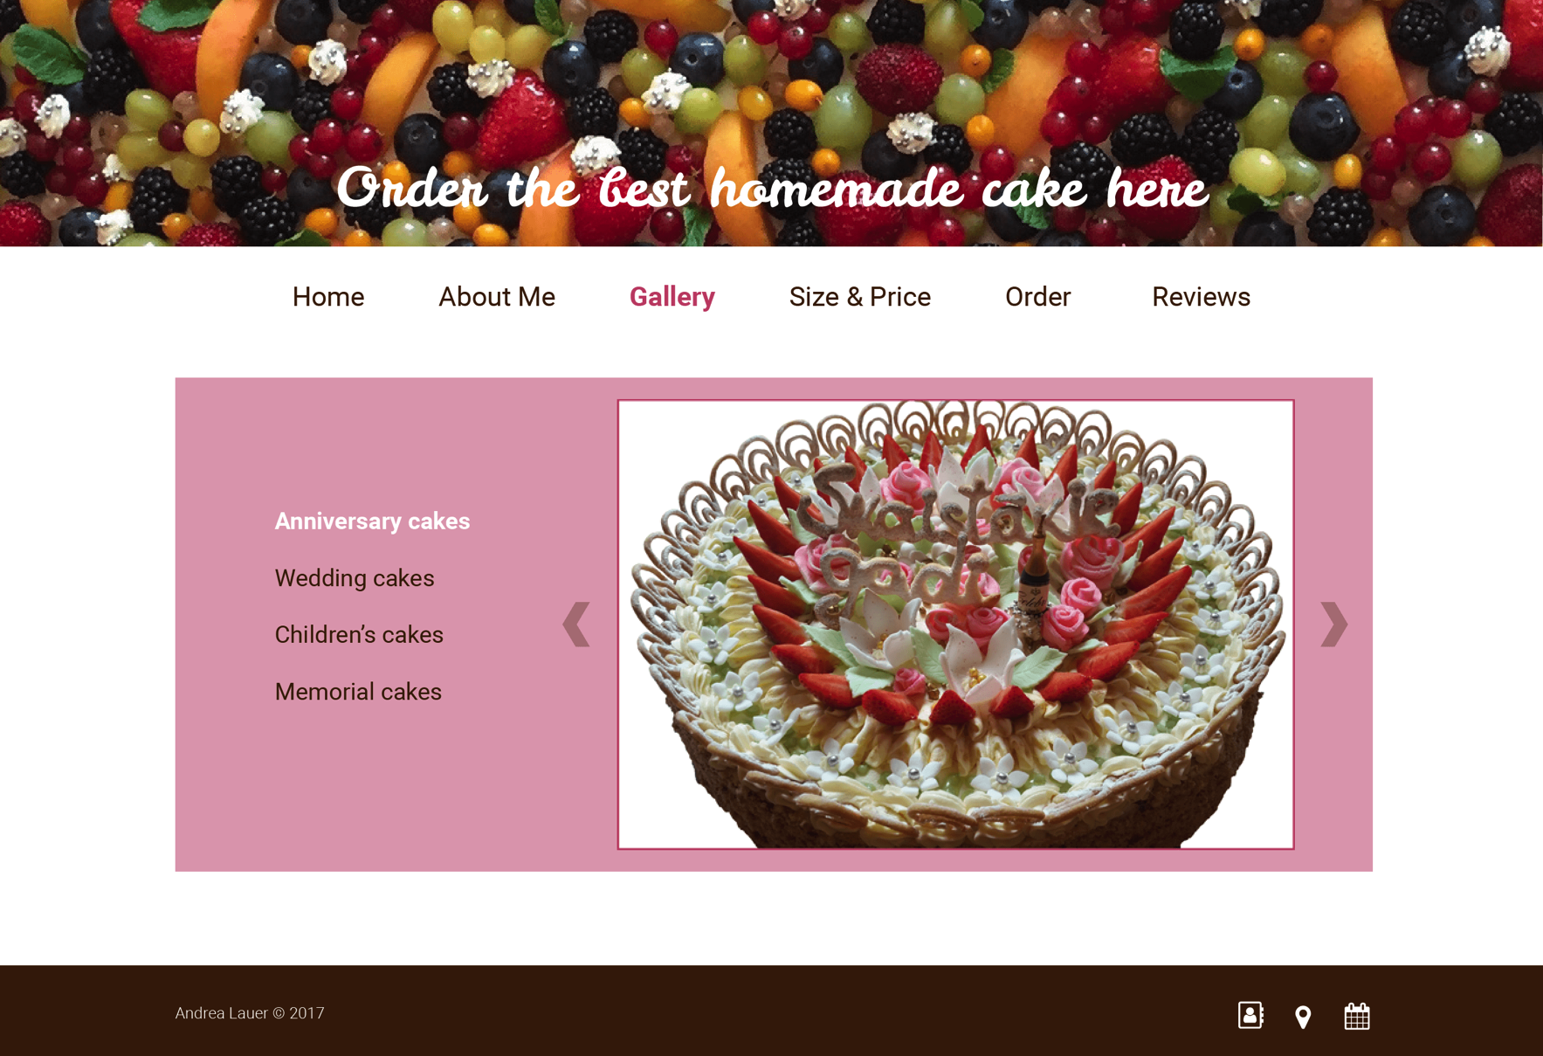
The second digital mockup for website’s Gallery page

Slide 12
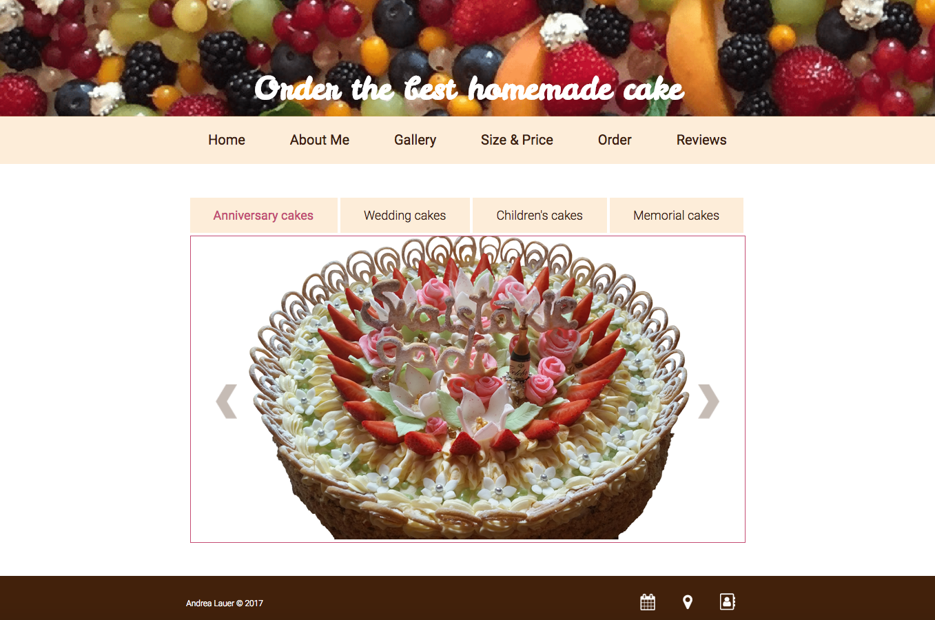
The website’s final Gallery page

Slide 13
Challenges
Spending a lot time learning, trying, and failing in order to code
Coded all pages and inserted all main elements without precise layout
Tried to find a solution for different issues
Applying styles, especially for layouts and object positioning
Lack of JavaScript knowledge
Did not use JavaScript as much as I could have
Used linking pages instead
When necessary to use JavaScript (e.g., the gallery section) could use it with a help from a friend

Slide 14
Challenges
Realized that the website does not look exactly like the prototype
The same elements look and “feel” different due to the size and proportions of the elements
The screen seems wider, font size - sometimes smaller, sometimes larger
The same pictures or assets also appear larger on the website

Slide 15
If I Could Do the Website Over Again
Create more realistic sketches that can be coded
Better plan for sizes of elements and spaces between them for each page
Organize style sheets differently
Create different digital mockup boards to see colors and typefaces

Slide 16
Next Steps
Fine-tuning the website, correcting issues, adding more JavaScript code
Setting up an online payment option
Merchant Account
Payment gateway account
PayPal, Google Wallet, Google Checkout, Authorize.net, Dwolla, etc. ???
Translating the website into Latvian and adding the language choice button
Adding more pictures to the gallery

Slide 17
Client Feedback
It’s very important to take qualitative pictures
Will provide pictures to add to the website
Realized how complicated and expensive is online payment systems
Will use bank transfer for now
The client did not approve having her picture on the website
Generally very happy with the result
Easy to navigate
Visually appealing
Works as advertisement

Slide 18
Thank You For Your Attention

